Slide 1
Nuclear Fuels
NE 201 Fall 2022
Dr. Benjamin Beeler

Slide 2
Fuel is the Heat Source
Although the fuel is a relatively small part of a reactor system, it determines thermal power, which drives electric power generation
The performance of the fuel is measured by:
How much heat is delivered to the coolant
The length of time it operates without any problems
How well it performs during an accident

Slide 3
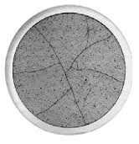
How much heat is delivered to the coolant?
Heat transport is related to thermal conductivity
In single crystal, pristine materials, thermal conductivity is reasonably straightforward
In dynamic, radiation environments, thermal conductivity degrades, fission gas bubbles form, grain boundaries are generated and destroyed
How does thermal conductivity vary?

Slide 4
The length of time fuel operates without any problems
There are 98 operating nuclear reactors in the US, producing 20% of the electricity
The net capacity factor is the ratio of an actual electrical energy output to the maximum possible electrical energy output over a period of time
Nuclear reactor capacity factor is ~92% over the past decade
The ability to maintain high capacity factor, limit shutdown time, is key in making nuclear power economical
Fuel is the primary component forcing reactor downtime

Slide 5
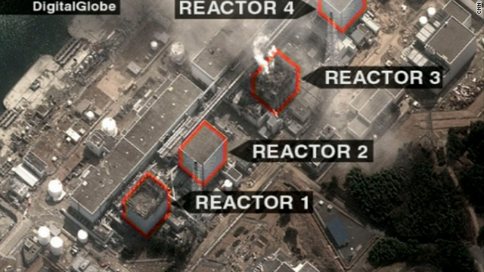
Fuel behavior during accidents
Fukushima
In addition to normal operating conditions, the behavior of the fuel during accidents is of critical importance
Predictable, and hopefully stable, behavior is desired during a variety of accident scenarios
Even low impact accidents are detrimental to public opinion surrounding nuclear energy

Slide 6
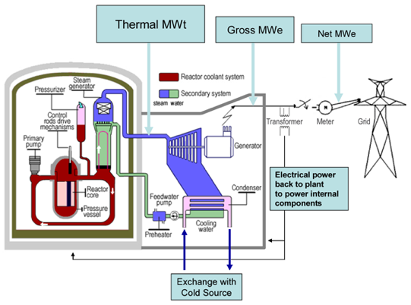
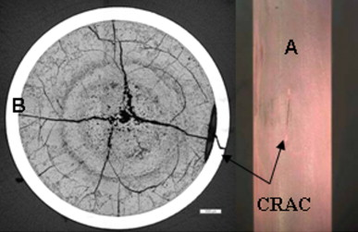
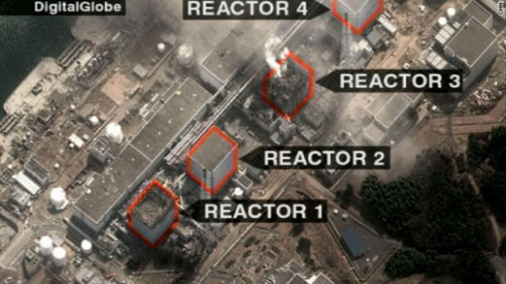
All of these factors together represent what we call “fuel performance”
Fuel Performance
Heat generation
Fuel problems causing unscheduled outages
Fuel behavior during an accident

Slide 7
Fuel Considerations
Safety:
Stable and predictable behavior
No melting, no phase changes under transients that lead to deleterious behavior
Uranium density
Mechanical integrity
Cladding interactions
Swelling and fission gas release
Operating temperatures

Slide 8
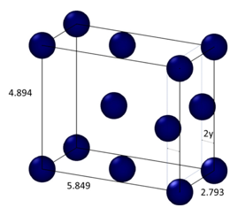
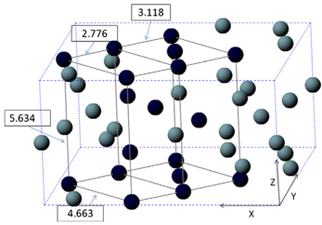
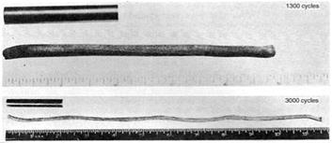
Why not use pure uranium metal?
Pure uranium has three phases
α-phase is orthorhombic
β-phase is tetragonal
γ-phase is body-centered cubic
During thermal cycling, pure uranium dramatically swells
Alpha U has both anisotropic thermal expansion and anisotropic irradiation growth

Slide 9
Fuel Types and Associated Reactor Types
UO2 – Light Water Reactors
Mixed oxide (MOX)
Accident tolerant/Advanced Technology Fuel (ATF)
UZr – Sodium Cooled Fast Reactors
UMo – Research Reactors
UC/UCO – High Temperature Gas Reactors
UN – Lead Cooled Fast Reactors
Other

Slide 10
Uranium Dioxide (UO2)
Reference fuel for nuclear power industry
Single phase, fluorite structure
Fabrication via sintering UO2 powder into pellets
Water coolant
Pellets are stacked inside Zircaloy cladding tubes

Slide 11
Uranium Dioxide (UO2)
Good Characteristics
Very high melting point, about 2800 C
Maintains a stable fluorite phase up to melting
Very compatible with Zircaloy clad (no interaction zones forming/no FCCI)
Relative stability in water
Reasonably radiation resistant
no amorphization
Can incorporate a large number of fission products as substitutional defects

Slide 12
Uranium Dioxide (UO2)
Bad Characteristics
Brittle (thermal stress fractures, fragmentation)
Poor thermal conductivity
Properties very sensitive to stoichiometry
Limited linear heating rates
Non-negligible thermal expansion/swelling
Higher stored thermal energy than other fuel materials

Slide 13
Uranium Dioxide (UO2)
Critical Phenomena
Thermal conductivity (and degradation)
Fission gas release, leading to pressure increase inside the cladding
Fuel fragmentation and relocation under transients
Bambooing creating stress concentrations
All 98 operational reactors in US utilize UO2

Slide 14
Mixed Oxides (MOX)
Can be combined with PuO2 for a mixed oxide (MOX) fuel for use in fast reactors
Allows to burn excess weapons grade plutonium
About 30 reactors in Europe currently utilize a partial MOX core
Similar behavior to UO2, but different neutronics, fission gas release, thermal conductivity, etc.
Less common is inclusion of minor actinides in MOX to burn waste

Slide 15
Accident Tolerant Fuel
Cr-doped UO2
Larger grain size, theoretically reduced fission gas release
Cr changes the O potential present within the fuel, changing defect concentrations and mobilities
Coatings or alternate claddings – FeCrAl or SiC
Improved radiation resistance, corrosion resistance, etc.

Slide 16
Uranium-Zirconium (UZr)
Utilized in sodium cooled fast reactors (SFRs)
EBR I, EBR II
Varied crystal structure and compositional environment
Easily alloyed with Pu, minor actinides (MA)
Can function as a breeder/burner fuel
Sodium coolant
Fe-based cladding

Slide 17
Uranium-Zirconium (UZr)
Alloy metallic U with Zr to increase the melting point and to stabilize the high temperature body-centered cubic phase
Interesting phenomena
30-50% swelling
Constituent redistribution
Alpha tearing
FCCI

Slide 18
Uranium-Zirconium (UZr)
Good Characteristics
High thermal conductivity
Stability to high burnups (> 20%)
Flexible composition
Inherent safety- negative reactivity feedback
Good compatibility with Na coolant
Bad Characteristics
Low melting point
Dramatic fuel swelling that must be accounted for
Incredibly complex microstructures/unpredictable behavior
Fuel-Clad Chemical Interaction
Very easily oxidized

Slide 19

Uranium-Molybdenum (UMo)
New fuel being qualified for research reactors
Fuel foil, with Zr diffusion barrier, Al cladding
Will be utilized in ATR, NBSR, MITR, MURR

Slide 20
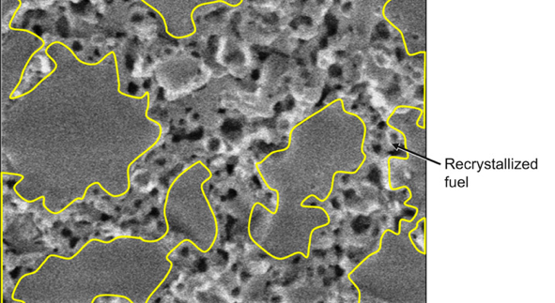
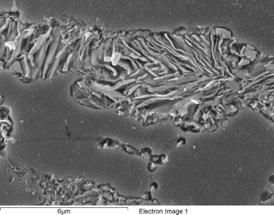
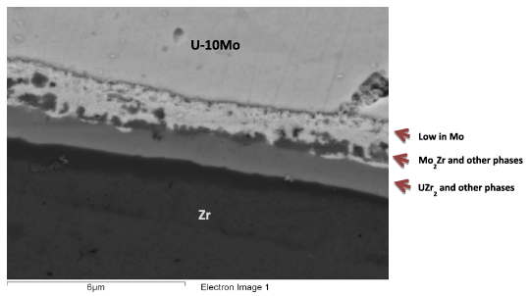
Uranium-Molybdenum (UMo)
Microstructural phenomena of interest:
Decomposition
Fission Gas Superlattice
Recrystallization
Inter-diffusion region
Carbides

Slide 21
UC/UCO TRISO Fuels
TRISO: TRistructural ISOtropic particle fuel
Layered fuel in mm-sized particles
Layers:
Fuel Kernel
Buffer
Inner Pyrolitic Carbon (IPyC)
SiC
Outer Pyrolitic Carbon (OPyC)

Slide 22
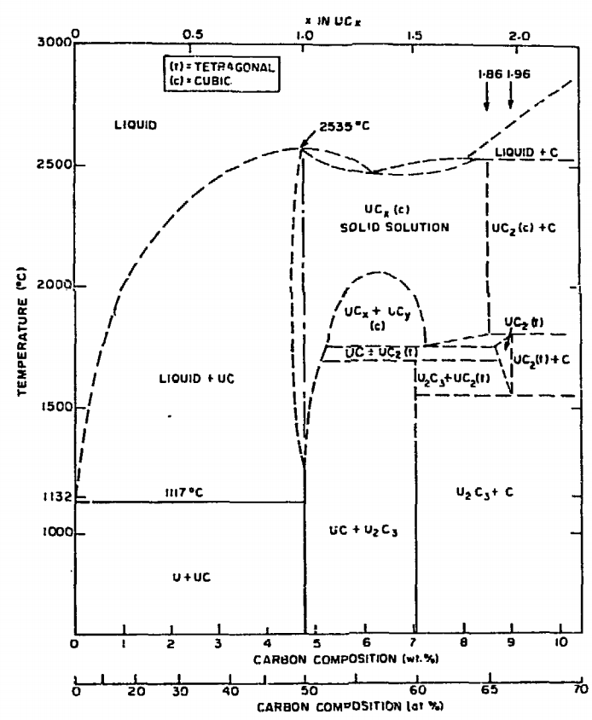
UC/UCO TRISO Fuels
Can appear as UC, U₂C₃, or UC₂
Advantages
High thermal conductivity
High fuel density
Thermally stable
High melting temperature
Disadvantages
Rapidly corrodes in water
Reacts with some cladding

Slide 23
UC/UCO TRISO Fuels
High temperature gas reactors (HTGR) or molten salt reactors (MSRs)
Pebble bed and prismatic types
Particles are agglomerated with graphite into a larger pebble, or into a cylindrical block
Current designs utilize UCO, which is a heterogeneous mixture of UO2 and UC fuel
Helium cooled gas or molten salt cooled

Slide 24
UC/UCO TRISO Fuels
Each individual pebble acts as its own containment, and allows fuels to go to much higher burnups and higher temperatures than UO2
Highly reliant on accurate fabrication processes that create high integrity, uniform layers and spherical particles
Integrity of the SiC is key for fission product retention

Slide 25
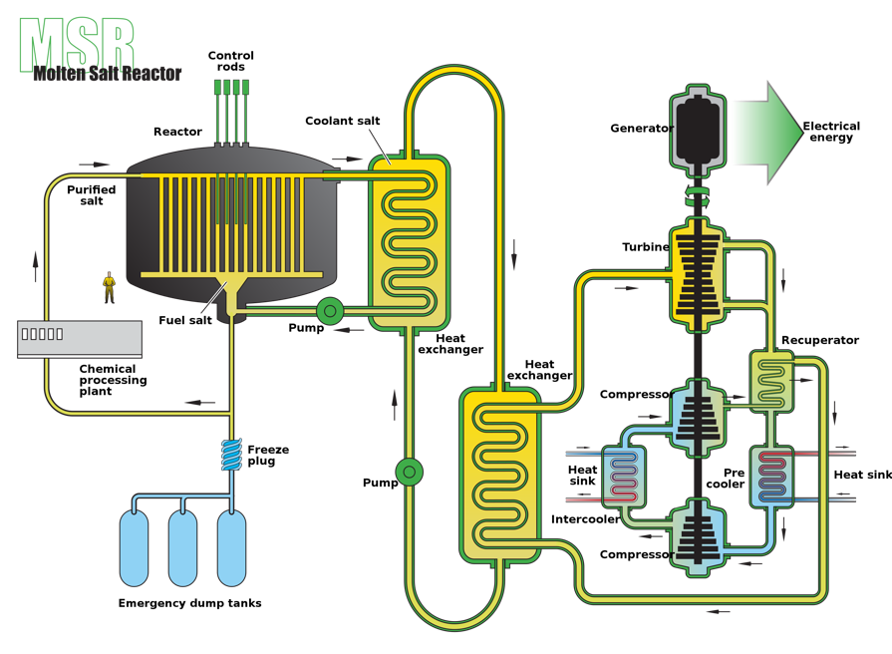
Molten Salt Reactors
Molten Salt Reactor
Utilizes flowing fuel salt (i.e., UF4-ZrF4-KF) with a secondary molten salt coolant loop (FLiBe)
MSRE at ORNL, some modern designs
Stable Salt Reactor
Utilizes fuel that is dissolved in molten salts (NaCl-(U/Pu)Cl3), contained in rods
Molten salt coolant (NaF-ZrF, FLiBe, FLiNaK, etc.)
Can mix other actinides into the fuel in order to burn waste
Designed to be inherently safe (passive)
Molten salt corrosion is a big problem, as well as the lack of information on thermophysical properties of complex salt

Slide 26
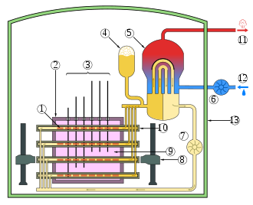
CANDU Reactors
Canada Deuterium Uranium: pressurized heavy water reactor
Natural uranium, as UO2, as the fuel source
Heavy water is the coolant, has a lower absorption of neutrons
Fuel pins are horizontal, as opposed to vertical
CANDU can be refueled online
Removes costs associated with enrichment

Slide 27
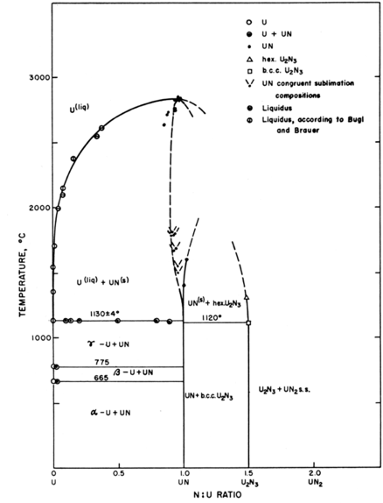
UN – Lead Cooled Reactors
Fuel can appear as UN, U₂N₃, or UN₂
Advantages
High thermal conductivity
High fuel density
Thermally stable
High melting temperature
Disadvantages
Corrodes in water
Reacts with some cladding
Difficult to manufacture
Requires N-enrichment
Pb or Pb-Bi metal coolant
Operates in a fast spectrum

Slide 28
Unique Fuel Designs
Lightbridge
High Zr content UZr alloy
Cruciform geometry fuel rods, combined into fuel elements
Kairos
TRISO particle compacts with low density core
Float in molten salt coolant for online refueling
NASA/LANL
UMo fuel for space reactors: KRUSTY

Slide 29
Fuel Summary Table
Property | UZr | UO₂ | UC | UN | U₃Si₂
Corrosion resistance in water | Very poor | Excellent | Very poor | Poor | Very Poor
Compatibility with clad materials | Reacts with normal clad | Excellent | Variable | Variable | Variable
Thermal stability | Phase change at 665 and 770 °C | Good | Good | Good | Good
Uranium (metal) density (g/cm³) | 19.04 | 9.65 | 12.97 | 13.52 | 11.31
Melting point (°C) | 1132 | 2865 | 2850 | 2860 | 1665
Thermal conductivity (W/m-K) | 38 at 430 °C | 3 at 1000°C | 25 at 500°C | 20 at 750°C | 23 at 773°C

Slide 30

Fuel Types Summary
There exist a number of nuclear fuels in different stages of utilization and development
Uranium is combined with O, C, N, transition metals for a variety of fuel types
UO2: ceramic, commercial reactor fuel, light water reactors
Each reactor design or application has individual needs, and no one fuel is one size fits all
Need to balance safety, performance (normal, off-normal, extended), manufacturability, processing, waste, etc.

Slide 31
Questions?

